Slide 1
AFFIRM

Slide 4
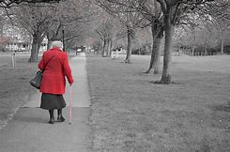

Slide 5
Life is a journey (movement)
Life is a process (change)
Life is a life long life time
(experiences, lessons)

Slide 6
Our (Christian) goal is to hang with people and continually encourage movement toward God. In doing this we are affirming their intrinsic value and expressing confidence in God’s love and purpose for them.

Slide 7
God can do a NEW WORK
in any life!

Slide 8
We must never minimize the value of any soul or refuse to recognize its potential.

Slide 9
God can do a RESTORING WORK in any life!

Slide 10
When a life has been damaged, God can rebuild that life, bringing goodness and greatness back to them.

Slide 11
● Connect
● AFFIRM
● Reach
● Equip
● Send

Slide 12
Part of our purpose is to embrace people as they go through the painful process of the Potters’ Wheel of Life.

Slide 13
Ananias and Saul had nothing in common when Saul gave his heart to Christ. Yet Ananias immediately reached out to affirm him.

Slide 14
AFFIRM

